Slide 1
Cornerstone City Church Peninsula Plus Community Hoo Are Ya
11th May 2025

Slide 2


Slide 3


Slide 4


Slide 5
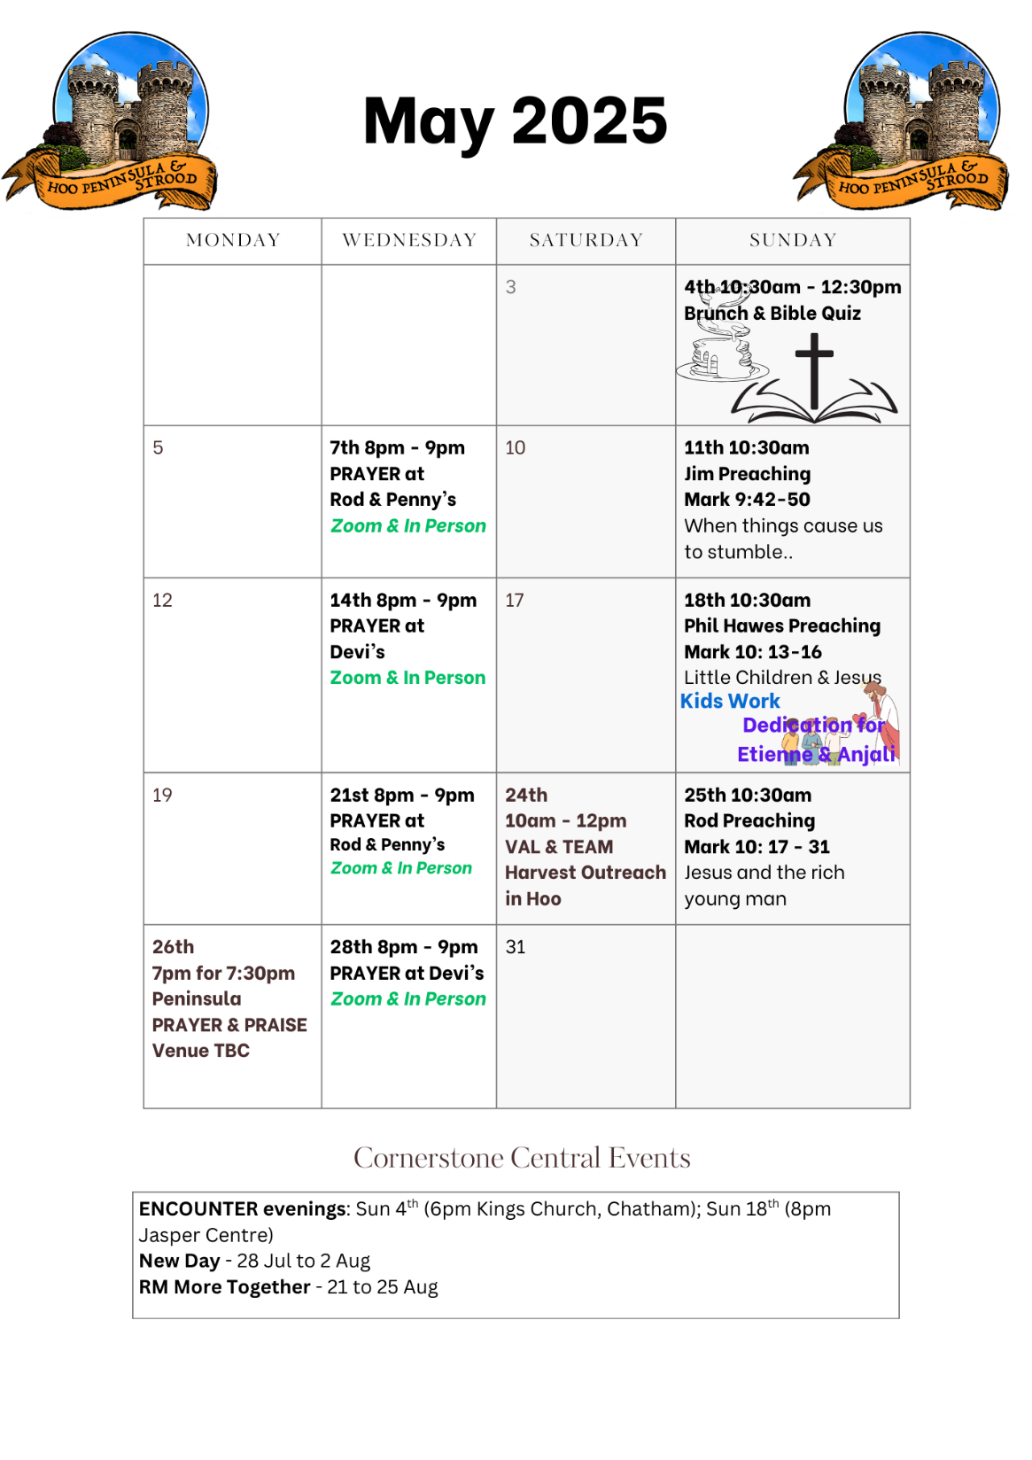

Slide 6

Grow Group 1
On YOUR MARK!

Slide 7
Leaders
Leaderss
Phil & Kim
Maria (Mia) Warren
Matthew Harrison
Richard & Elisha Acheampong
Phil & Kim
Maria (Mia) Warren
Matthew Harrison
Richard & Elisa Acheampong

Slide 8

Storm Walker
Storm Walker
Symbolising, trust in Jesus Christ through life's storms.
Mark 4:35-41

Slide 9



Group Leaders
Micheal and Mwamba
Wilfred and Parveen
Hannah

Slide 10


Slide 11


Slide 12


Slide 13
I reach Up High
CCLI Song # 1075387
Judy Bailey
© 1993 Song Solutions Daybreak (Admin. by Song Solutions www.songsolutions.org)
For use solely with the SongSelect® Terms of Use. All rights reserved. www.ccli.com
CCLI Licence No. 33265

Slide 14
1/3
I reach up high I touch the ground
I stomp my feet and turn around
I've got to (woo woo) Praise the Lord
I jump and dance with all my might
I might look funny but that's alright
I've got to (woo woo)
Praise my Lord

Slide 15
2/3
I'll do anything just for my God
'Cause He's done ev'rything for me
It doesn't matter who is looking on
Jesus is the person that I want to please

Slide 16
3/3
May my whole life be a song of praise
To worship God in ev'ry way
In this song the actions praise His name
I want my actions ev'ry day to do the same

Slide 17
Praise
CCLI Song # 7213077
© Brandon Lake MusicFor Humans PublishingMaverick City PublishingCapitol CMG GenesisCapitol CMG ParagonHousefires SoundsWriter's Roof PublishingMusic by Elevation Worship Publishing
For use solely with the SongSelect® Terms of Use. All rights reserved. www.ccli.com
Note: Reproduction of this sheet music requires a CCLI Music Reproduction Licence. Please report all copies.
CCLI Licence No. 33265

Slide 18
1/12
Let everything that has breath
Praise the Lord
Praise the Lord

Slide 19
2/12
I’ll praise in the valley
Praise on the mountain
I’ll praise when I’m sure
Praise when I’m doubting

Slide 20
3/12
I’ll praise when outnumbered
Praise when surrounded
'Cause praise is the water
My enemies drown in

Slide 21
4/12
As long as I’m breathing
I’ve got a reason to Praise the Lord oh my soul
Praise the Lord oh my soul

Slide 22
5/12
I’ll praise when I feel it
And I’ll praise when I don’t
I’ll praise 'cause I know
You’re still in control

Slide 23
6/12
'Cause my praise is a weapon
It’s more than a sound
My praise is the shout
That brings Jericho down

Slide 24
7/12
As long as I’m breathing
I’ve got a reason to Praise the Lord oh my soul
Praise the Lord oh my soul

Slide 25
8/12
I won’t be quiet
My God is alive
How could I keep it inside
Praise the Lord oh my soul

Slide 26
9/12
I’ll praise 'cause You’re sovereign
Praise 'cause You reign
Praise 'cause You rose and defeated the grave
I’ll praise 'cause You’re faithful
Praise 'cause You’re true
Praise 'cause there’s nobody greater than You

Slide 27
10/12
Praise the Lord oh my soul
Praise the Lord oh my soul
Praise the Lord oh my soul
Praise the Lord oh my soul
I won’t be quiet
My God is alive
How could I keep it inside

Slide 28
1 1/12
I won’t be quiet
My God is alive
How could I keep it inside
I won’t be quiet
My God is alive
How could I keep it inside
Praise the Lord oh my soul

Slide 29
12/12
Let everything that has breath
Praise the Lord
Praise the Lord

Slide 30
House Of The Lord
CCLI Song # 7168995
© 2020 Phil Wickham MusicSimply Global SongsBe Essential SongsCashagamble Jet Music
For use solely with the SongSelect® Terms of Use. All rights reserved. www.ccli.com
Note: Reproduction of this sheet music requires a CCLI Music Reproduction Licence. Please report all copies.
CCLI Licence No. 33265

Slide 31
1/9
We worship the God who was
We worship the God who is
We worship the God who evermore will be
He opened the prison doors
He parted the raging sea
My God He holds the victory yeah

Slide 32
2/9
There’s joy in the house of the Lord
There’s joy in the house of the Lord today
And we won’t be quiet
We shout out Your praise

Slide 33
3/9
There’s joy in the house of the Lord
Our God is surely in this place
And we won’t be quiet
We shout out Your praise

Slide 34
4/9
We sing to the God who heals
We sing to the God who saves
We sing to the God who always makes a way
'Cause He hung up on that cross
Then He rose up from that grave
My God’s still rolling stones away

Slide 35
5/9
There’s joy in the house of the Lord
There’s joy in the house of the Lord today
And we won’t be quiet
We shout out Your praise

Slide 36
6/9
There’s joy in the house of the Lord
Our God is surely in this place
And we won’t be quiet
We shout out Your praise

Slide 37
7/9
We were the beggars
Now we’re royalty
We were the prisoners
Now we’re running free
We are forgiven accepted
Redeemed by His grace
Let the house of the Lord sing praise
(REPEAT)

Slide 38
8/9
There’s joy in the house of the Lord
There’s joy in the house of the Lord today
And we won’t be quiet
We shout out Your praise

Slide 39
9/9
There’s joy in the house of the Lord
Our God is surely in this place
And we won’t be quiet
We shout out Your praise

Slide 41
Goodness Of God
CCLI Song # 7117726
Ben Fielding | Brian Johnson | Ed Cash | Jason Ingram | Jenn Johnson
© 2018 Capitol CMG Paragon (Admin. by Capitol CMG Publishing)
Fellow Ships Music (Admin. by Essential Music Publishing LLC)
So Essential Tunes (Admin. by Essential Music Publishing LLC)
SHOUT! Music Publishing Australia (Admin. by SHOUT! Music Publishing UK)
Bethel Music Publishing (Admin. by Song Solutions)
For use solely with the SongSelect® Terms of Use. All rights reserved. www.ccli.com
CCLI Licence No. 33265

Slide 42
1/6
I love You Lord
Oh Your mercy never fails me
All my days
I've been held in Your hands
From the moment that I wake up
Until I lay my head
I will sing of the goodness of God

Slide 43
2/6
All my life You have been faithful
All my life You have been so so good
With every breath that I am able
I will sing of the goodness of God

Slide 44
3/6
I love Your voice
You have led me through the fire
In darkest night
You are close like no other
I've known You as a father
I've known You as a friend
I have lived in the goodness of God

Slide 45
4/6
All my life You have been faithful
All my life You have been so so good
With every breath that I am able
I will sing of the goodness of God

Slide 46
5/6
Your goodness is running after
It’s running after me
(REPEAT)
With my life laid down
I’m surrendered now
I give You everything
Your goodness is running after
It's running after me

Slide 47
6/6
All my life You have been faithful
All my life You have been so so good
With every breath that I am able
I will sing of the goodness of God

Slide 48
Worthy Of it All
CCLI Song # 6280644
David Brymer | Ryan Hall
© 2012 Common Hymnal Publishing (Admin. by Integrity Music Ltd)
Innerland (Admin. by Integrity Music Ltd)
Underground Treasure (Admin. by Integrity Music Ltd)
Wayfinder Music (Admin. by Integrity Music Ltd)
For use solely with the SongSelect® Terms of Use. All rights reserved. www.ccli.com
CCLI Licence No. 33265

Slide 49
1/4
All the saints and angels
Bow before Your throne
All the elders cast their crowns
Before the Lamb of God and sing

Slide 50
2/4
You are worthy of it all
You are worthy of it all
For from You are all things
And to You are all things
You deserve the glory

Slide 51
3/4
Day and night,
Night and day,
Let incense arise
(X4)
Day and night
Night and day

Slide 52
4/4
You are worthy of it all
You are worthy of it all
For from You are all things
And to You are all things
You deserve the glory

Slide 54
Holy Forever
CCLI Song # 7201044
Brian Johnson | Chris Tomlin | Jason Ingram | Jenn Johnson | Phil Wickham
© Phil Wickham Music (Admin. by / Small Stone Media BV, Holland (Admin. in the UK/Eire by Song Solutions www.songsolutions.org))
Simply Global Songs (Admin. by / Small Stone Media BV, Holland (Admin. in the UK/Eire by Song Solutions www.songsolutions.org))
Capitol CMG Paragon (Admin. by Capitol CMG Publishing)
S. D. G. Publishing (Admin. by Capitol CMG Publishing)
Be Essential Songs (Admin. by Essential Music Publishing LLC)
My Magnolia Music (Admin. by Essential Music Publishing LLC)
Bethel Music Publishing (Admin. by Song Solutions)
Brian and Jenn Publishing (Admin. by Song Solutions)
For use solely with the SongSelect® Terms of Use. All rights reserved. www.ccli.com
CCLI Licence No. 33265

Slide 55
1/10
A thousand generations falling down in worship
To sing the song of ages to the Lamb
And all who've gone before us
And all who will believe
Will sing the song of ages to the Lamb

Slide 56
2/10
(Jesus) Your name is the highest
Your name is the greatest
Your name stands above them all
All thrones and dominions
All powers and positions
Your name stands above them all

Slide 57
3/10
And the angels cry Holy
All creation cries Holy
You are lifted high Holy
Holy forever

Slide 58
4/10
If you've been forgiven and if you've been redeemed
Sing the song forever to the Lamb
If you walk in freedom and if you bear His name
Sing the song forever to the Lamb
We'll sing the song forever and amen

Slide 59
5/10
And the angels cry Holy
All creation cries Holy
You are lifted high Holy
Holy forever

Slide 60
6/10
Hear Your people sing Holy
To the King of Kings Holy
You will always be Holy
Holy forever

Slide 61
7/10
(Jesus) Your name is the highest
Your name is the greatest
Your name stands above them all
All thrones and dominions
All powers and positions
Your name stands above them all

Slide 62
8/10
And the angels cry Holy
All creation cries Holy
You are lifted high Holy
Holy forever

Slide 63
9/10
Hear Your people sing Holy
To the King of Kings Holy
You will always be Holy
Holy forever

Slide 64
10/10
You will always be Holy
Holy forever

Slide 65


Slide 66
2 Corinthians 14 May the grace of the Lord Jesus Christ, and the love of God, and the fellowship of the Holy Spirit be with you all
Surely goodness and mercy shall follow me all the days of my life, and I shall dwell in the house of the Lord forever.

